Slide 1
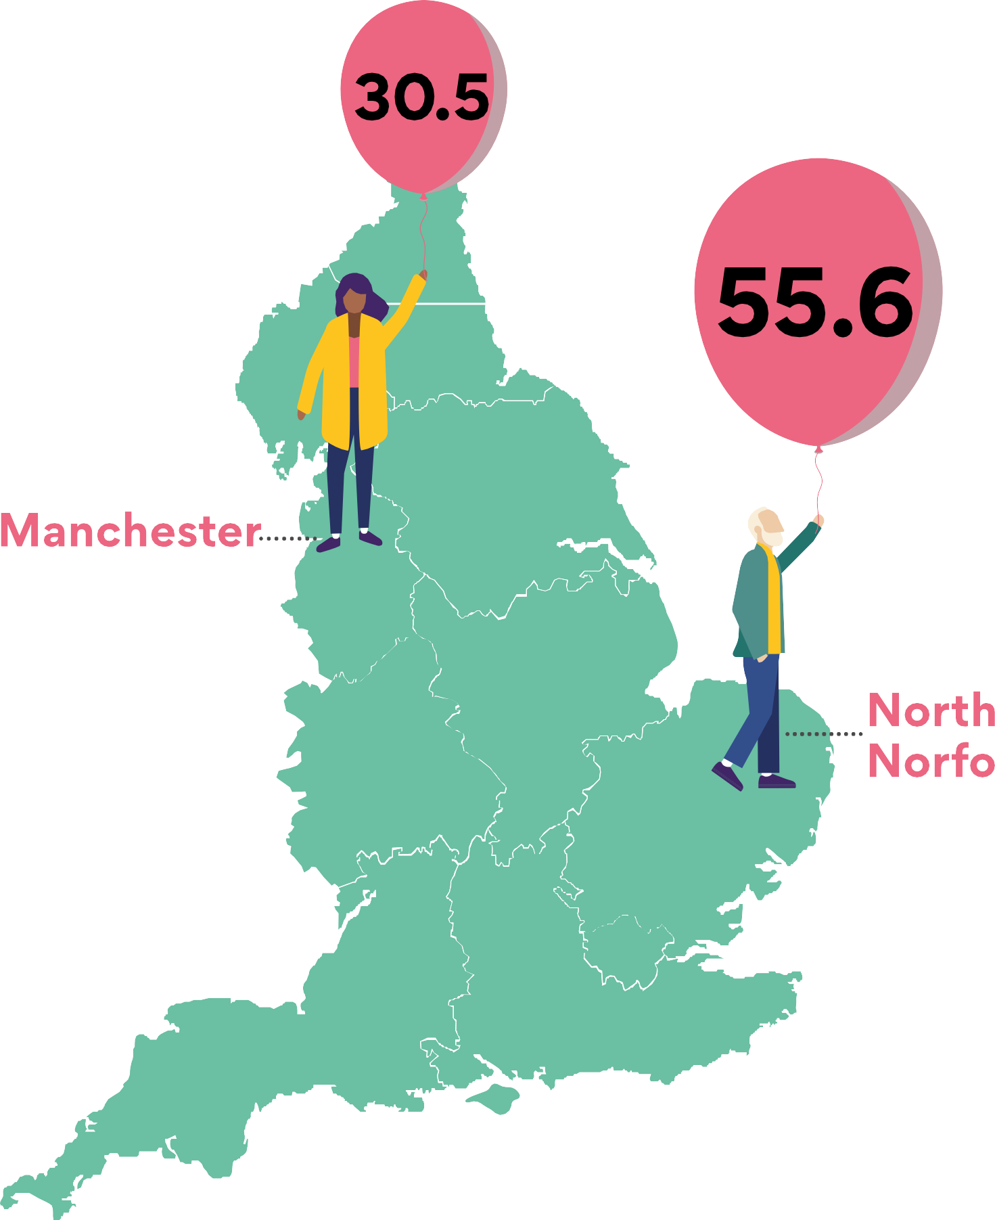


Our ageing population
The median age of people in England
is 40 but this ranges
from 31 in Manchester to 56 in North Norfolk.
Rural and coastal areas are ageing fastest.
For source see chart 2.02a here: https://ageing-better.org.uk/our-ageing-population-state-ageing-2025

Slide 2
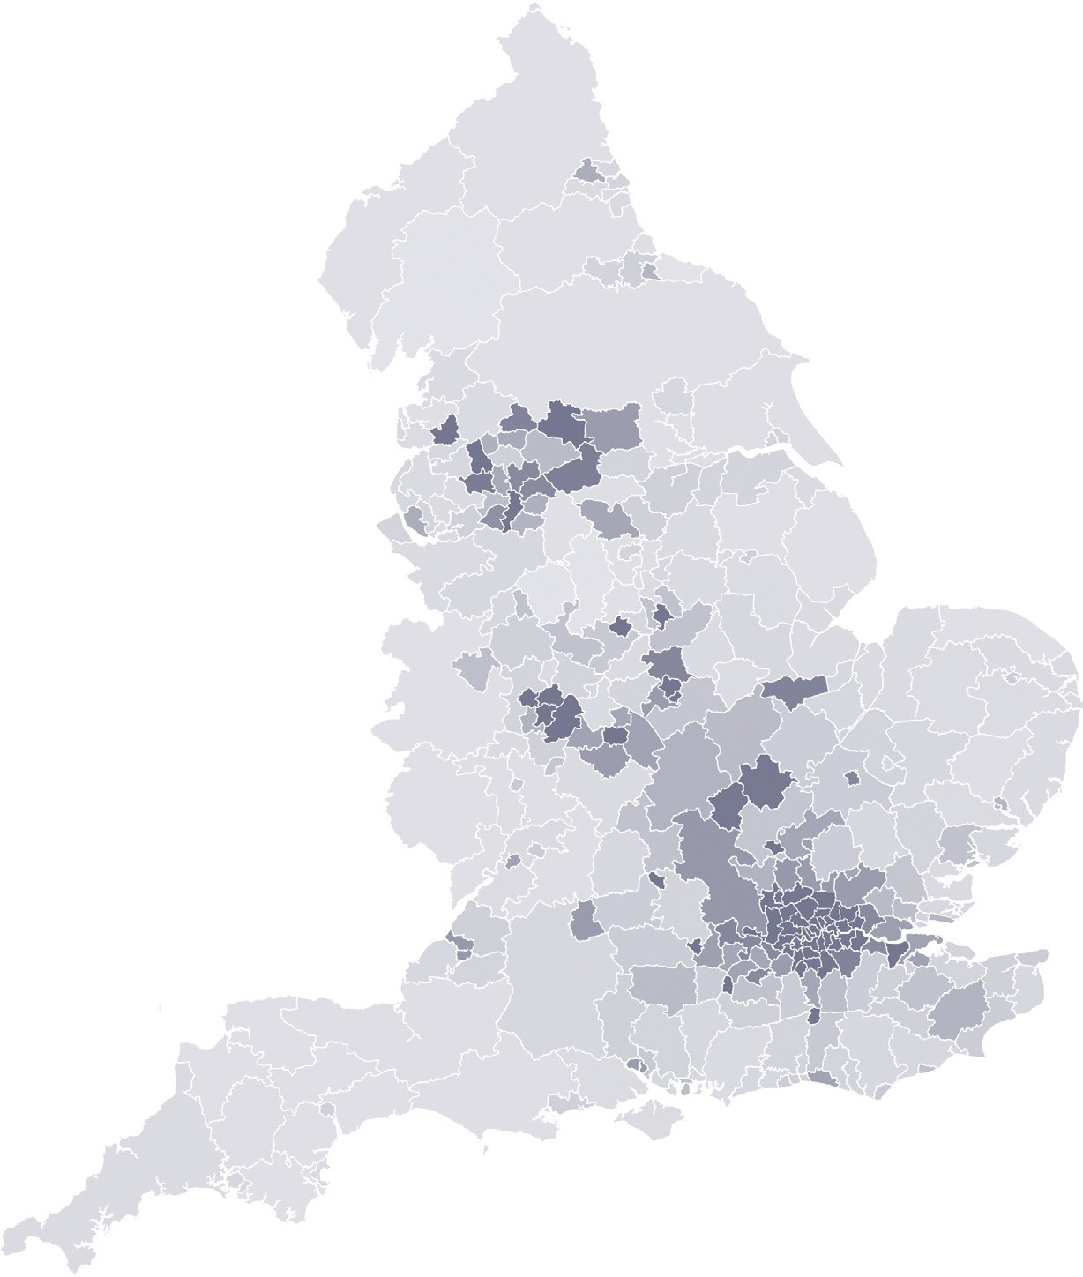
Our ageing population
Older people from minority ethnic backgrounds tend
to live in urban areas.
But the proportion of over 65s from these backgrounds is set to grow
in all areas of England.
Percentage of people aged 50 and over who are from Black, Asian or Minority Ethnic backgrounds (2021)
0% 20% 40% 60%
For source see chart 2.04a here: https://ageing-better.org.uk/our-ageing-population-state-ageing-2025

Slide 3
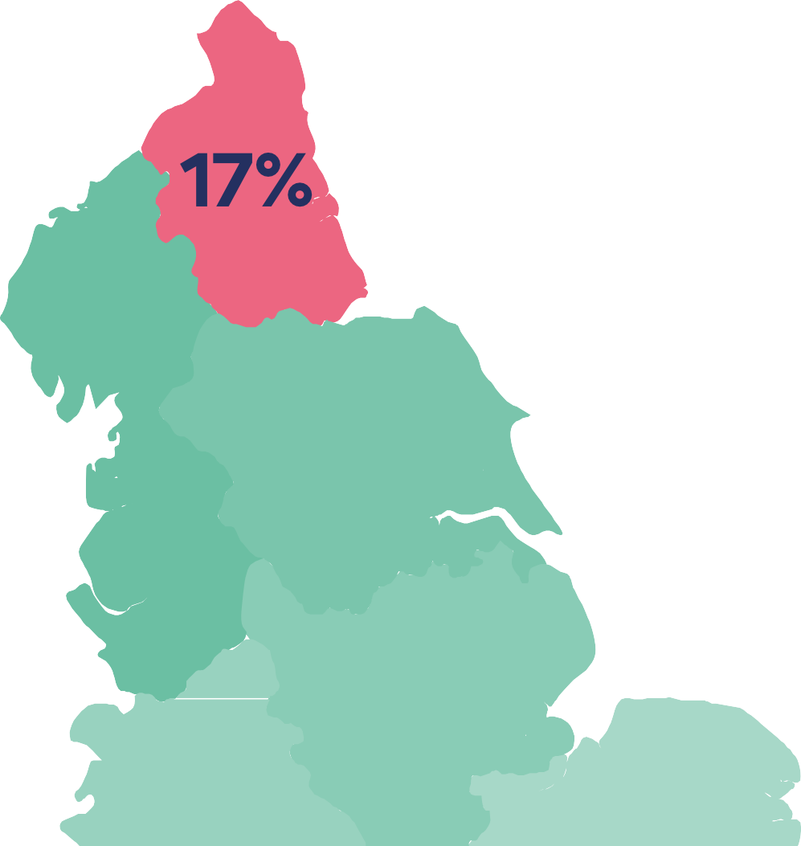
Our ageing population
People aged 50 to 64 who live in the regions with the worst health
and highest poverty
levels are most likely to provide unpaid care for others.
The North East region has the highest percentage of people aged 50 to 64 who provide unpaid care
For source see chart 2.07 here: https://ageing-better.org.uk/our-ageing-population-state-ageing-2025

Slide 4
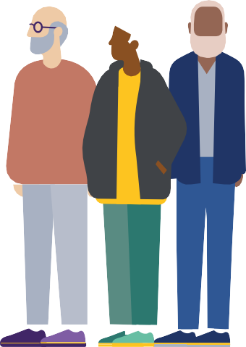
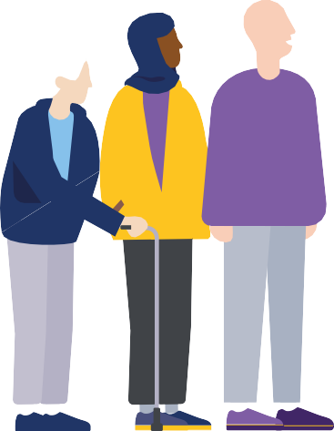

















Our ageing population
The biggest population increase over
the next 40 years
will be in people aged 80 and over.
Projected percentage change in size of each age group by 2065
For source see chart 2.03a here: https://ageing-better.org.uk/our-ageing-population-state-ageing-2025

Slide 5



















Our ageing population
The number of older men living alone is increasing rapidly.
It has increased by two-thirds in 20 years.
For source see chart 2.08 here: https://ageing-better.org.uk/our-ageing-population-state-ageing-2025

Slide 6















Our ageing population
Older Lesbian, Gay and Bisexual people tend
to live in London, larger
cities and coastal towns.
Older LGB+ people living outside these places are at greater risk of isolation.
Local authorities home to the largest number of LGB+ people aged 55 and over
For source see chart 2.05a here: https://ageing-better.org.uk/our-ageing-population-state-ageing-2025

Slide 7
Our ageing population
“We are an ageing population, and the services aren’t adapting enough to keep up with the ageing population process.”
Woman in her seventies, Knowsley
Source: Centre for Ageing Better (2025) State of Ageing 2025. [online] Available at: https://ageing-better.org.uk/state-ageing-2025

Slide 8





Work
The employment rate of people aged
50 to 64 in England is
14 percentage points lower than that of those aged 35 to 49.
The North East and London have the biggest gaps in employment rates between these age groups.
For source see charts 3.05 and 3.13 here: https://ageing-better.org.uk/work-state-ageing-2025

Slide 9













Work
The UK government has an ambition to increase the overall employment rate of people aged
Current employment rate of people aged 55-64
16 to 64 to 80% from
about 75% now.
But it will not succeed without increasing the employment rate of people aged 55
to 64 to levels seen in other OECD countries.
For source see chart 3.01 here: https://ageing-better.org.uk/work-state-ageing-2025

Slide 10
Work
Employment rates of those in their 60s have increased since 2016 alongside increases in the State Pension Age.
The proportion of people who are still working at the current State Pension Age of 66 has increased from 24% to 30% in
just 8 years.
For source see chart 3.02 here: https://ageing-better.org.uk/work-state-ageing-2025

Slide 11








Work
In the North West, half of people aged 50 to 65 who aren’t working are out of work because of their health while
in the South West
it’s one in three
Sickness is the main reason people aged 50 to 65 aren’t working.
For sources see charts 3.06 and 3.07 here: https://ageing-better.org.uk/work-state-ageing-2025.

Slide 12



Work
Older workers are much less likely to obtain a job through employment services than younger workers.
For source see chart 3.11 here: https://ageing-better.org.uk/work-state-ageing-2025

Slide 13

Work
350,000 people aged
50 to 65 with long-term health conditions would return to the workforce if the right support were in place.
For source see chart 3.06 here: https://ageing-better.org.uk/work-state-ageing-2025

Slide 14
Work
“I… done a few courses here, but why I wasn’t put forward for the job? And
when I asked, [I was told they] didn’t put
you forward because you old people don’t seem to fare well at interviews.”
Participant, Triage evaluation
Source: Centre for Ageing Better (2025) State of Ageing 2025. [online] Available at: https://ageing-better.org.uk/state-ageing-2025

Slide 15
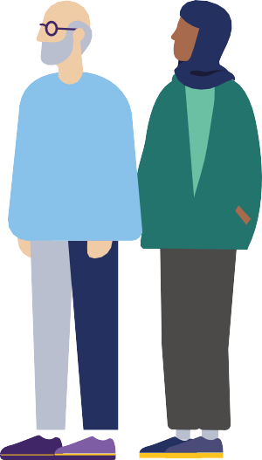







Homes
There are 3.5 million non-decent homes in
England. Half are headed
by someone aged 55 and over and of these
1.3 million are owner
occupied.
Homes are classed as non-decent for one of four reasons:
A serious hazard which poses a risk to health.
Not providing a reasonable degree of thermal comfort.
In disrepair.
Not having sufficiently modern facilities.
For source see chart 4.01a here: https://ageing-better.org.uk/homes-state-ageing-2025

Slide 16
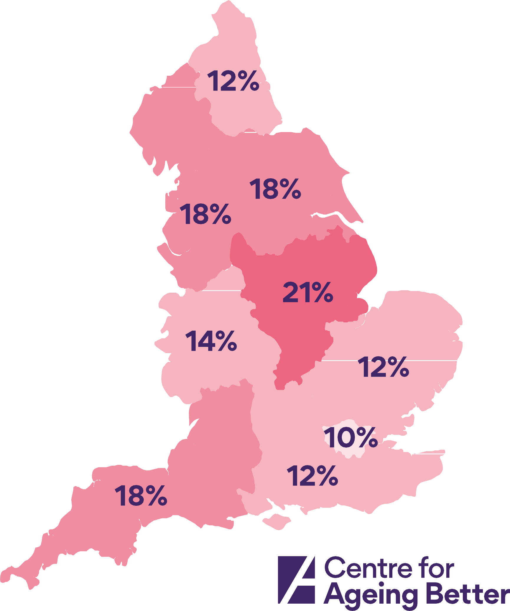
Homes
There are large disparities across the country in the scale of non-decency.
The percentage of owner occupied homes headed by someone aged 55 and over that are non-decent ranges from 10% in London to 21% in the East Midlands.
For source see chart 4.02a here: https://ageing-better.org.uk/homes-state-ageing-2025

Slide 17







Homes
Only one in eight homes in England
can be visited by people
with access needs.
The four features that make a home visitable for most people are:
A WC at entrance level
No steps between the pavement and the entrance
Sufficiently wide doorways and circulation space
A main entrance door that is free of obstructions higher than 15mm.
For source see chart 4.05a here: https://ageing-better.org.uk/homes-state-ageing-2025

Slide 18








Homes
People from Black, Asian and Minority Ethnic backgrounds are less likely than White people to be satisfied with their homes.
Owner-occupied sector only
For source see chart 4.07 here: https://ageing-better.org.uk/homes-state-ageing-2025

Slide 19

















Homes
There is a well-evidenced link between the condition of people’s homes and their mental health.
422,000 homeowners aged 55 and over who are living in
a non-decent home have anxiety.
Percentage of non-decent homes that have a household head aged 55+ who has anxiety
For source see chart 4.09b here: https://ageing-better.org.uk/homes-state-ageing-2025

Slide 20

Homes
Home ownership is no guarantee of financial security
Almost one in five people aged 50 and over who own their homes outright are living in poverty.
For source see chart 4.10 here: https://ageing-better.org.uk/homes-state-ageing-2025

Slide 21
Homes
“My old house… didn’t have double glazing and we were cold all the time…and my arthritis was worse there. [In our new house]… we have railings ...so I can go up the stairs. We do need a bathroom downstairs, but we will get it eventually. It’s very expensive...”
Woman in her sixties, Middlesbrough
Source: Centre for Ageing Better (2025) State of Ageing 2025. [online] Available at: https://ageing-better.org.uk/state-ageing-2025

Slide 22
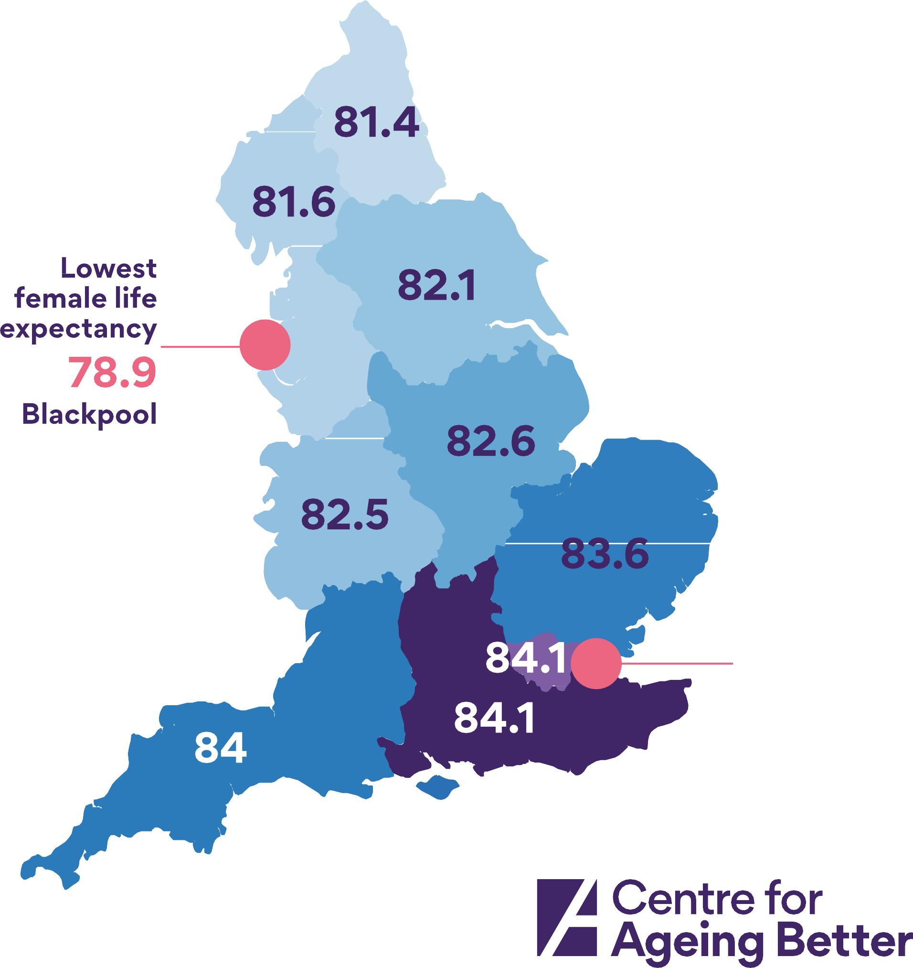







Health
Women living in the poorest places live shorter lives.
The poorest places tend to be in the north of England and urban in nature.
We see the same pattern for men, whose life expectancy ranges from
77.4 in the North East to 80.3 in the South East.
For source see chart 5.01a here: https://ageing-better.org.uk/health-and-wellbeing-state-ageing-2025

Slide 23






















Health
How long you live
in good health varies across the country.
There is a difference of 7 years for men and 6 years for women between the North East and South East.
For source see chart 5.02 here: https://ageing-better.org.uk/health-and-wellbeing-state-ageing-2025

Slide 24
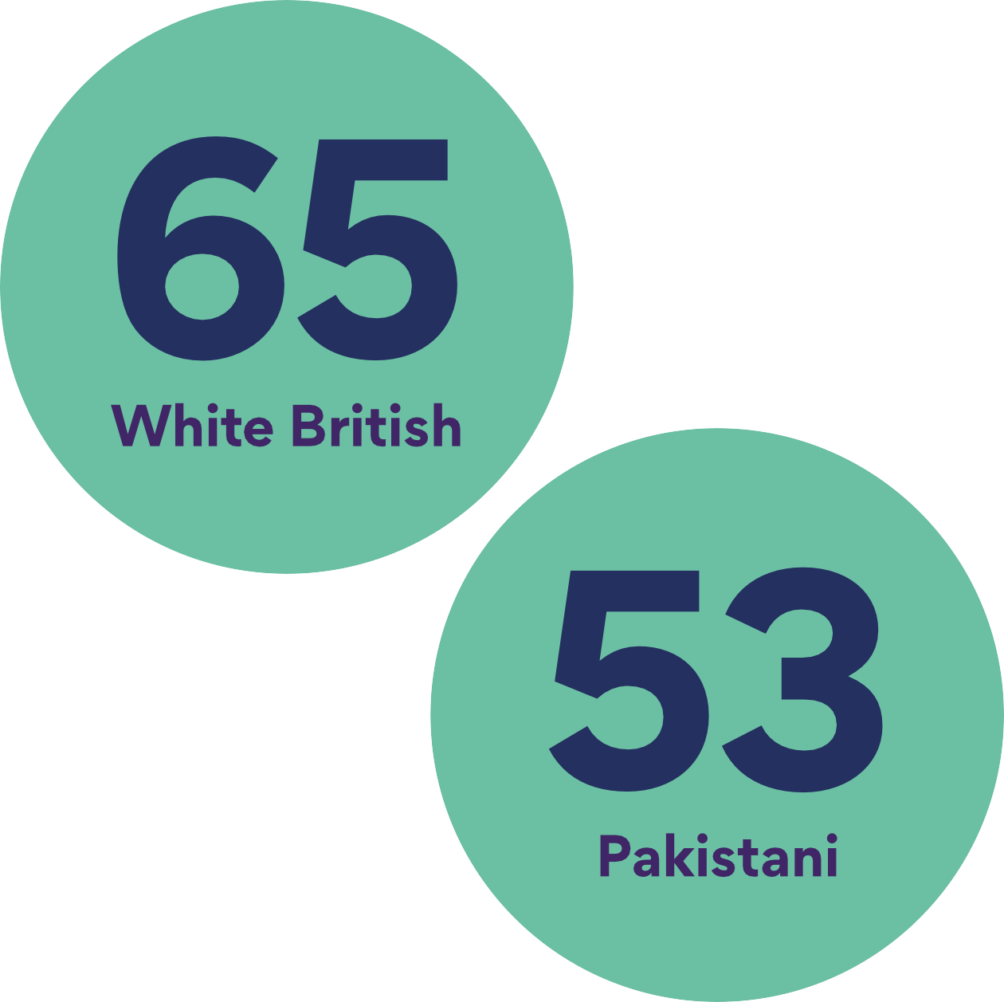

Health
Bangladeshi and Pakistani people experience poor health younger than those from other ethnic groups.
Age at which 10% of people are in bad or very bad health
Source: Census 2021. Available at: https://www.ons.gov.uk/datasets/create/filter-outputs/454838fa-81fb-4e19-b020-32755d070c39#get-data

Slide 25
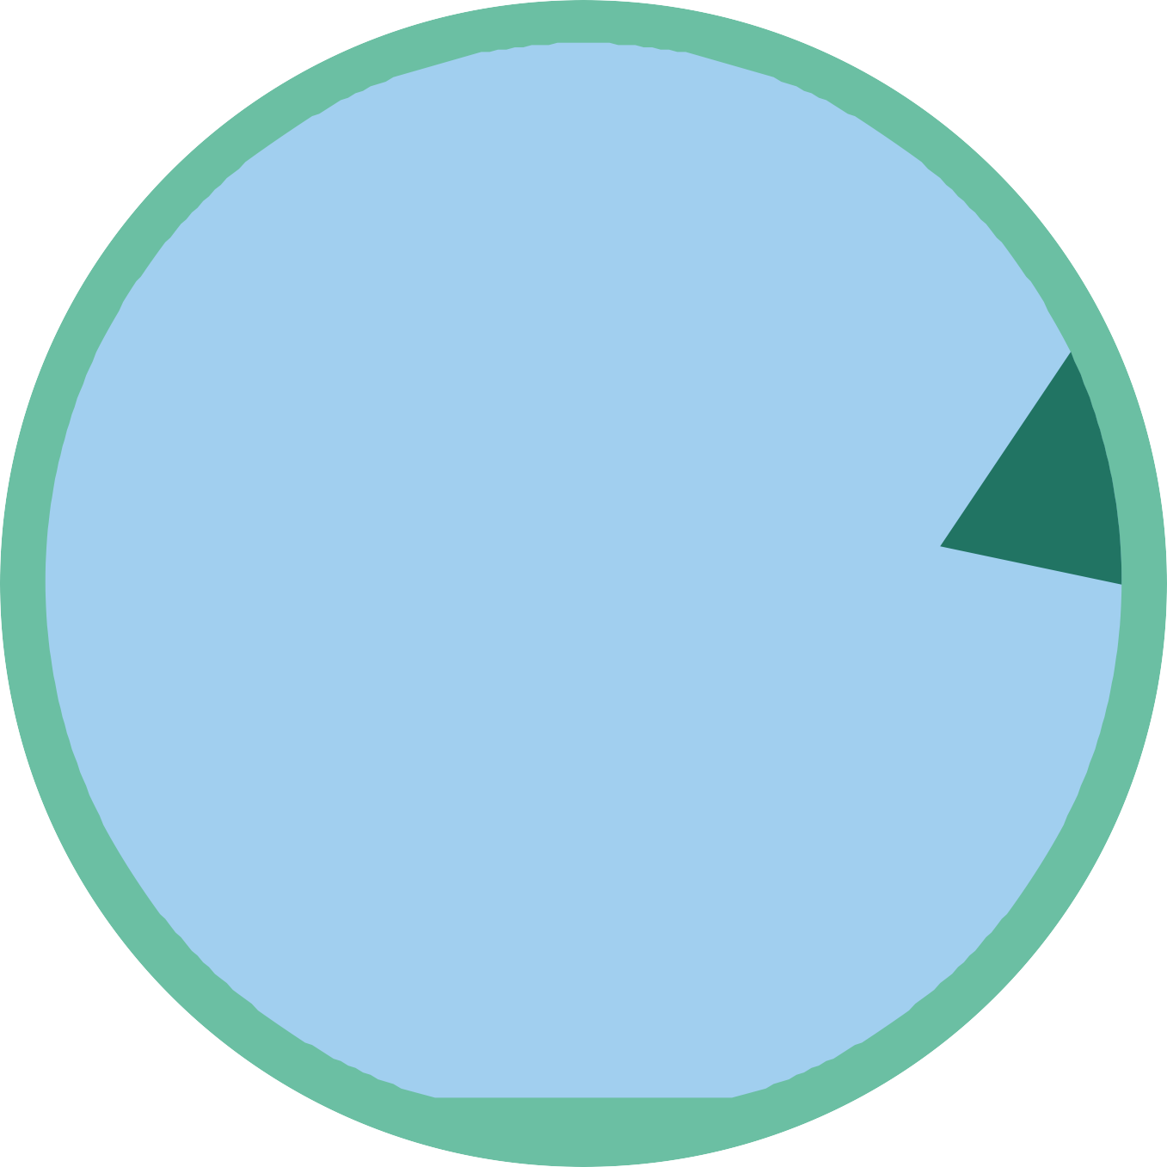




















Health
The oldest places in England aren’t necessarily the ones in worst health.
Places that are older than average with a better than average health profile tend to be rural.
For source see chart 5.04 here: https://ageing-better.org.uk/health-and-wellbeing-state-ageing-2025

Slide 26







































Health
Healthy life expectancy in England is in decline.
It is 20 months lower for
men and 22 months lower for women than for the last pre-pandemic period of 2017/19.
For source see chart 5.05b here: https://ageing-better.org.uk/health-and-wellbeing-state-ageing-2025

Slide 27



Health
People aged 50 to 69 living in the most deprived areas in England are nearly 3 times more likely to have a health problem or disability that affects their daily life as those in the least deprived areas.
*IMD, Index of Multiple Deprivation
For source see chart 5.08 here: https://ageing-better.org.uk/health-and-wellbeing-state-ageing-2025

Slide 28
Health
“It’s how we make Knowsley as a whole more equal, because we’ve got health inequalities… you’ve a greater risk of dying if you live in that area of Knowsley than if you live in [another area], and it just feels absolutely mad that, doesn’t it?”
Woman in her seventies, Knowsley
Source: Centre for Ageing Better (2025) State of Ageing 2025. [online] Available at: https://ageing-better. org.uk/state-ageing-2025

Slide 29
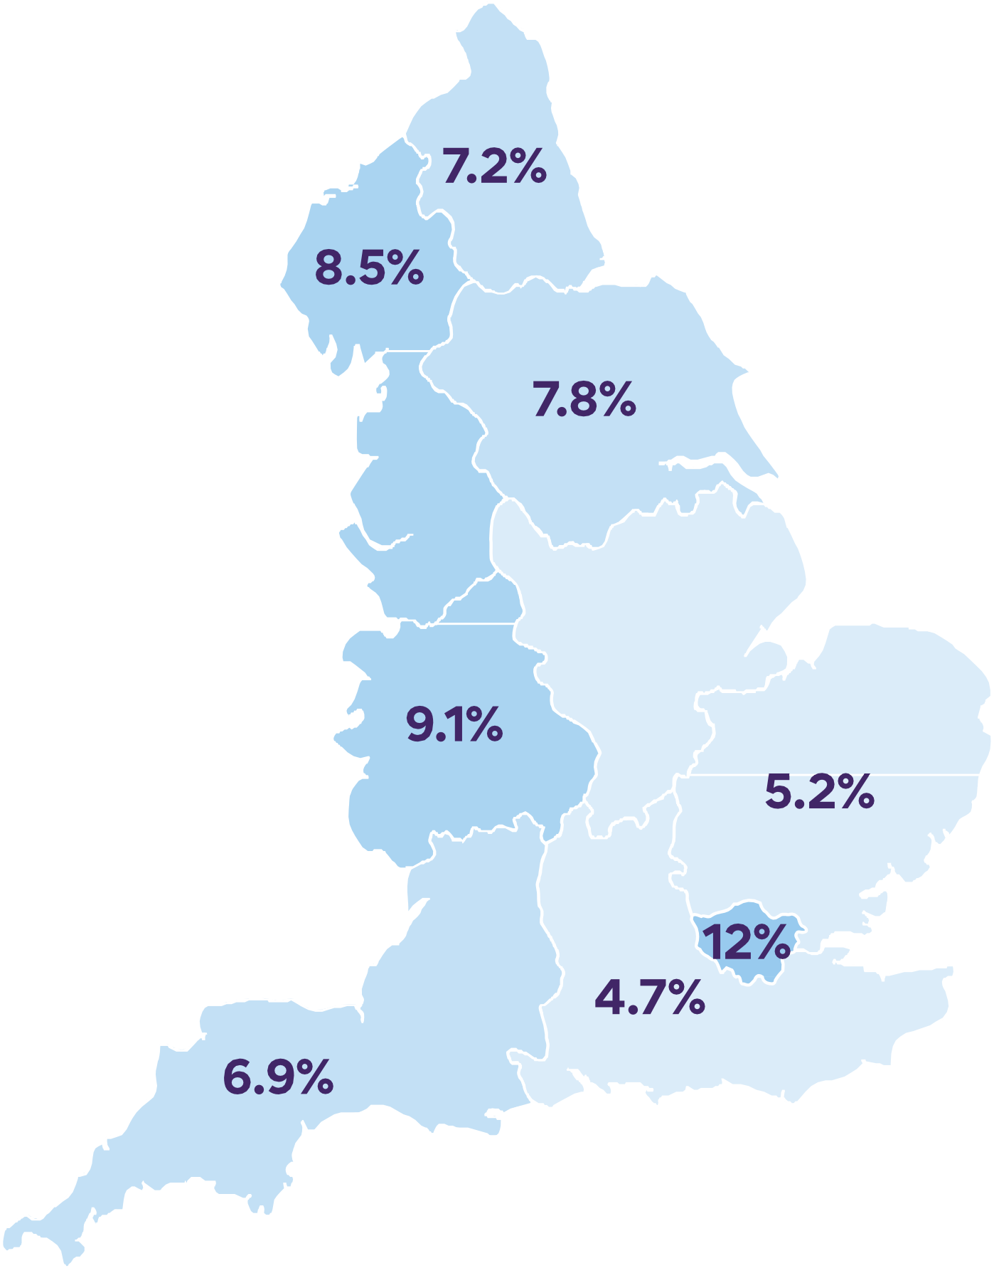























Financial security
1 million pensioners are living in material
deprivation. That means
they don’t have enough money or resources to afford basics such as
a warm coat and at least
one filling meal a day.
Rates vary across the country from less than 5% in the South East to 12% in London.
For source see chart 6.10 here: https://ageing-better.org.uk/financial-security-state-ageing-2025

Slide 30







































Financial security
The state pension, even when it is topped up with Pension Credit, does not provide pensioners with
a basic standard
of living.
The Minimum Income Standard (MIS) is the income people need to reach a socially acceptable standard of living
For source see chart 6.03 here: https://ageing-better.org.uk/financial-security-state-ageing-2025

Slide 31



















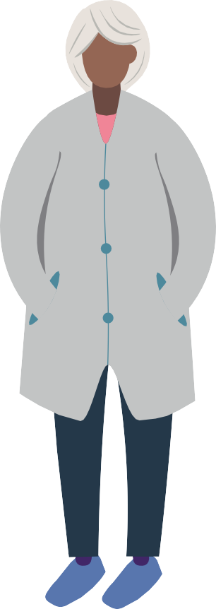

























Financial security
The poorest pensioners have virtually no income from occupational pensions.
Weekly income from occupational pensions
For source see charts 6.04a and 6.04b here: https://ageing-better.org.uk/financial-security-state-ageing-2025

Slide 32
Financial security
One in ten pensioners have no savings at all.
And a quarter have less than £1,500.
Single female pensioners are the most likely to have no or low savings.
For source see chart 6.06 here: https://ageing-better.org.uk/financial-security-state-ageing-2025

Slide 33























































Financial security
A large proportion of older people are experiencing financial pressures because of the
cost-of-living crisis.
For source see chart 6.11 here: https://ageing-better.org.uk/financial-security-state-ageing-2025

Slide 34
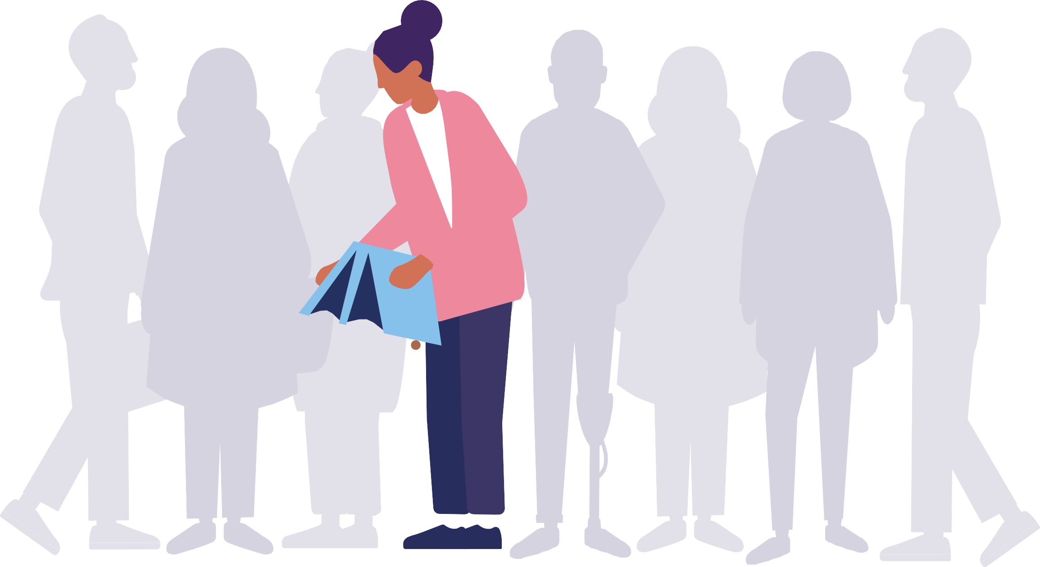
Financial security
One in eight people above state pension age have no income apart from the state pension and among single pensioners, the proportion is one in five.
Source: An adequate income in later life https://www.independentage.org/sites/default/files/2024-11/Income_adequacy_briefing_1.pdf

Slide 35
Financial security
“I will probably have to work till I’m 67 because that’s when I’ll get my state pension… I opted out of a workplace pension. I’ve been
working since I was 16. I’m nearly 62 now and I don’t have a pension to show for it.”
Woman in her sixties, Knowsley
Source: Centre for Ageing Better (2025) State of Ageing 2025. [online] Available at: https://ageing-better.org.uk/state-ageing-2025

Slide 36


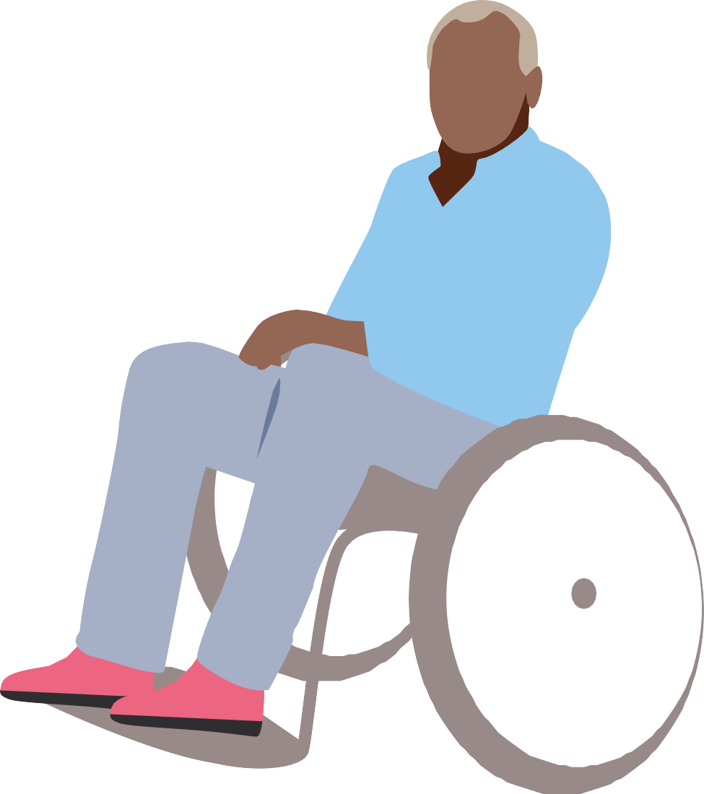
Society
People aged 65 to 74 are more likely to volunteer (both formally and informally) than any other age group
But older people living in more deprived areas are likely to face greater barriers to volunteering caused by poor health and disability.
For sources see charts7.01 and 7.03b here: https://ageing-better.org.uk/ society-state-ageing-2025

Slide 37


















Society
Men aged 65 and over are less likely than women of the same age to receive support as carers.
Almost three-quarters of male carers receive no support from any source.
For source see chart 7.05 here: https://ageing-better.org.uk/ society-state-ageing-2025

Slide 38



















Society
A feeling of safety and the availability of green and natural spaces are the most
common reasons why
people aged 50 and over are proud to live in their local area.
For source see chart 7.09 here: https://ageing-better.org.uk/ society-state-ageing-2025

Slide 39

Society
More than a third
of women have been patronised because of their age since turning 50.
For source see chart 7.12 here: https://ageing-better.org.uk/ society-state-ageing-2025

Slide 40























Society
Although spending on some community services has started to recover since 2021,
the impact of a decade
of cuts remains greatest in the most deprived areas.
Of people aged 50 and over who are not proud of their local area...
For sources see chart 7.09 here: https://ageing-better.org.uk/ society-state-ageing-2025
and https://ifs.org.uk/publications/how-have-english-councils-funding-and-spending-changed-2010-2024

Slide 41
Society
Although internet use has increased among older people, many are still excluded from digital services.
The proportion of people aged 65 and over who don’t use
the internet at home dropped from 29% to 27% between 2023
and 2024.
3.5 million
people aged 65 and over don’t use the internet at home.
For source see chart 7.13 here: https://ageing-better.org.uk/ society-state-ageing-2025

Slide 42
Society
“It does need a lot of changes here, and there has been a lot of regeneration, but
I don’t think it’s been rapid enough. There’s a lot of derelict areas… I would move out of the area unless I see something that
encourages me, and it doesn’t at this moment.”
Man in his seventies, Knowsley
Source: Centre for Ageing Better (2025) State of Ageing 2025. [online] Available at: https://ageing-better.org.uk/state-ageing-2025

